Slide 1
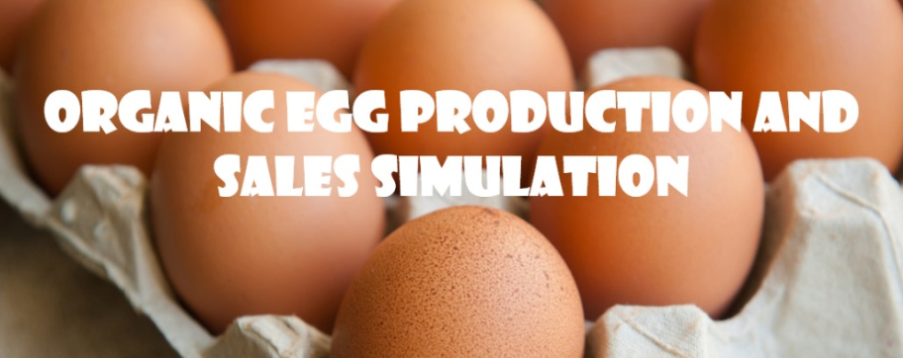

Christian Thieme
DATA604
7/16/2020

Slide 2
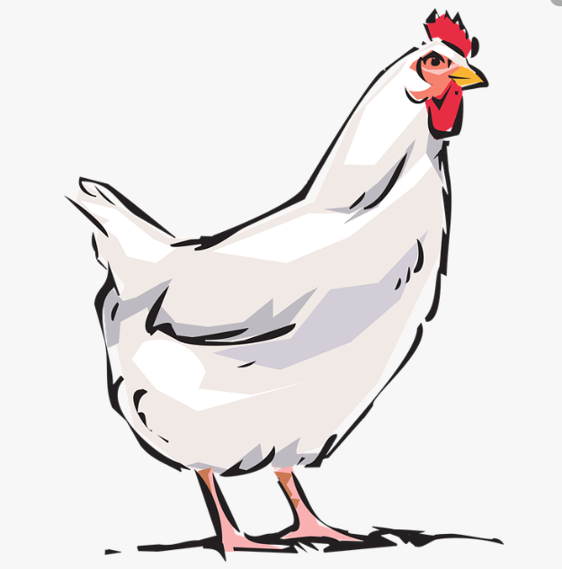
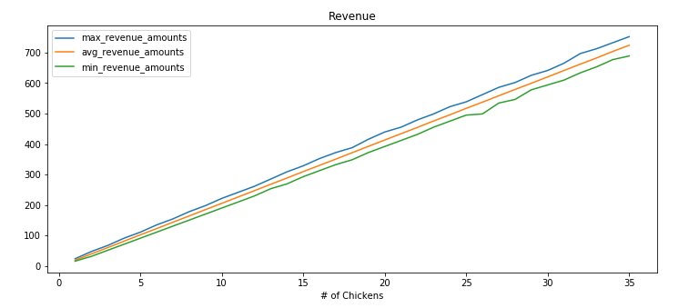
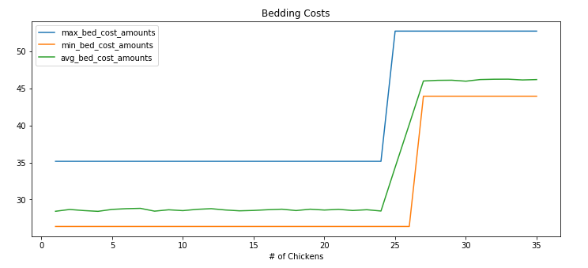
PROBLEM STATEMENT: How Many Chickens Should I Get?
The desire for organic, fresh, natural food is on the rise – many people want to get into the game by selling organic produce or products from organic livestock
Chickens are the easiest area to break into when it comes to livestock
While revenue from selling eggs is linear, COSTS ARE NOT
A 35 lbs bag of feed might feed 5 chickens for a month, but if you had 6 chickens you would need to buy a second bag every month, essentially doubling your costs
Costs tend to follow a stair step trend
The number of chickens you can have is limited by the area you have for them to live.
At certain thresholds, costs increase – this means that more isn’t always better and that there is an optimal number of chickens within the given range you can maintain (i.e. 15-25 chickens based on living space requirements).

Slide 3
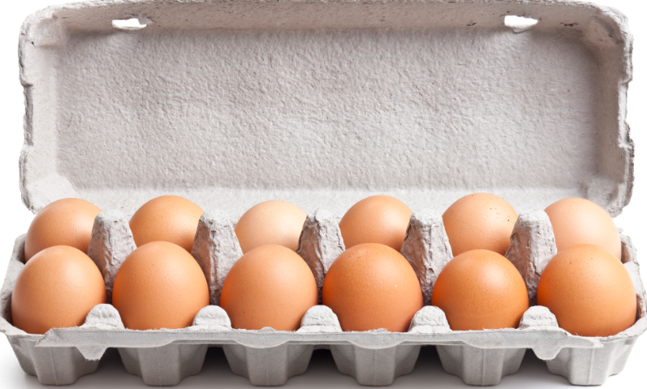
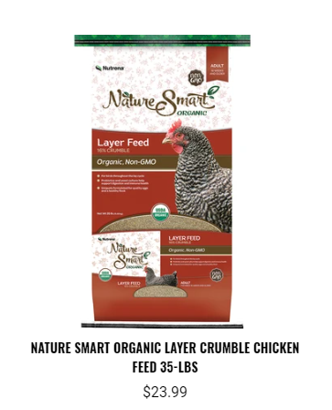
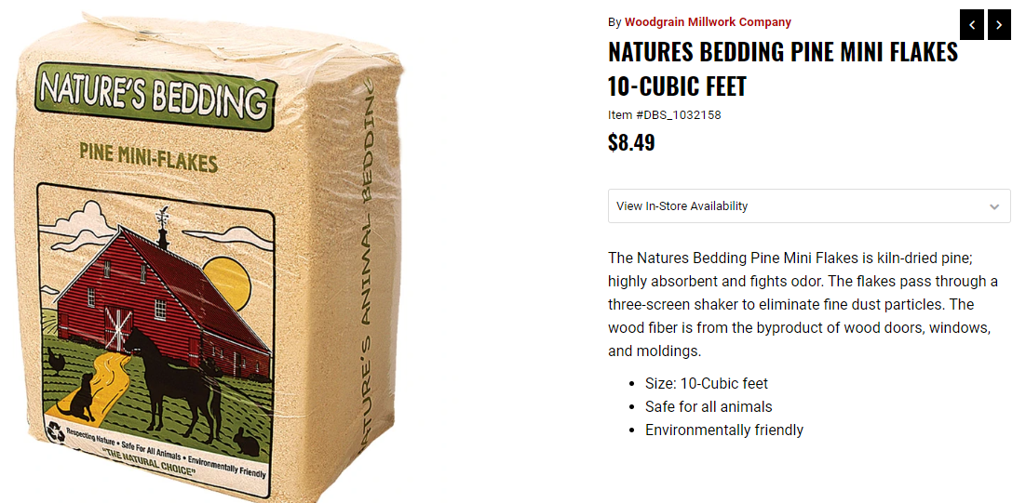
How Does it Work?
For the casual hen owner (1-50 chickens) looking to sell eggs, there are really three areas of interest that need to be accounted for:
Revenue - How much money do you make from the sale of dozens of eggs?
2. Feed Cost - The cost of feeding your chickens
3. Bedding Cost - The cost of buying and replacing bedding that periodically gets soiled
REVENUE
FEED COST
BEDDING COST
---------------------------
= GROSS PROFIT
Three separate models combined to get Gross Profit

Slide 4
Revenue
Egg Production for One Chicken for One Day
Yes
1
Done for every chicken for every day
Start
Chicken
Egg?
Based on probability distribution
No
0
Sum Outcomes
/12 for dozen
# of dozen x sale price
End

Slide 5
Feed Cost
Feed Consumption for One Chicken for One Day
Multiplied by # of Chickens and Days being simulated
Start
Chicken
Eats x lbs of Feed
Based on probability distribution
Consumed > lbs in bag?
Bag of feed: x lbs
No
Yes
Cost of Bag
lbs Consumed /lbs in bag
End
Bags needed x Cost of Bag
End

Slide 6
Bedding Cost Cost
Bag of Bedding: x cubic feet
Days Until Bedding Change
Chickens to use 10 cubic feet
Days in Simulation
# of Chickens
Based on probability distribution
Based on probability distribution
Usage for all chickens for a single period
Rate of usage per chicken
Determining multiplier for how many times the bedding needs to be changed
10 /
Chickens to use 10 cubic feet
Start
Start
Days Until Bedding Change
/ Days in Simulation
Rate x # of Chickens
Times needed to refresh during simulation
Single Period
/ cubic feet in bag
Multiply
Cost of Bedding
Cubic feet needed for 1 changing period for all chickens
End

Slide 7
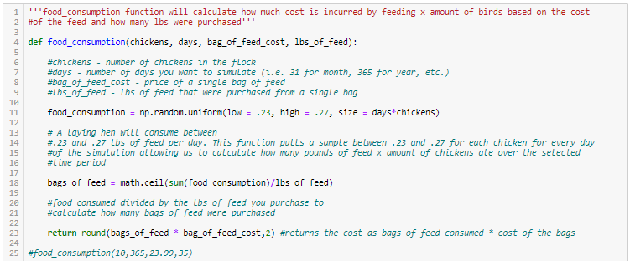
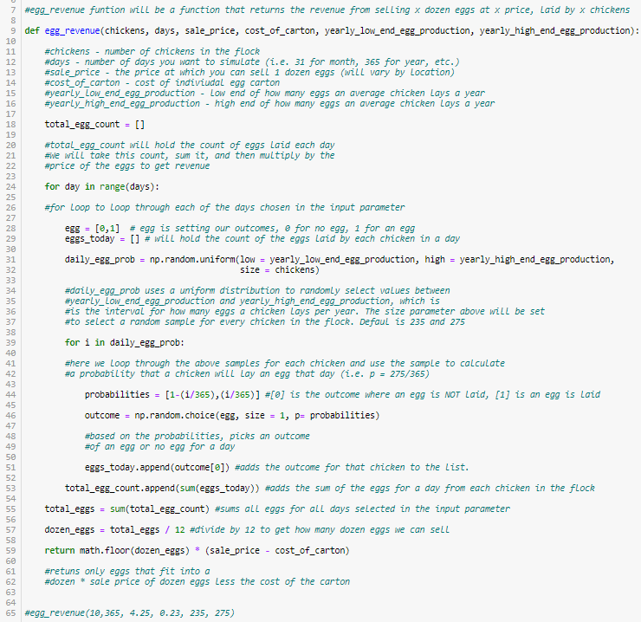
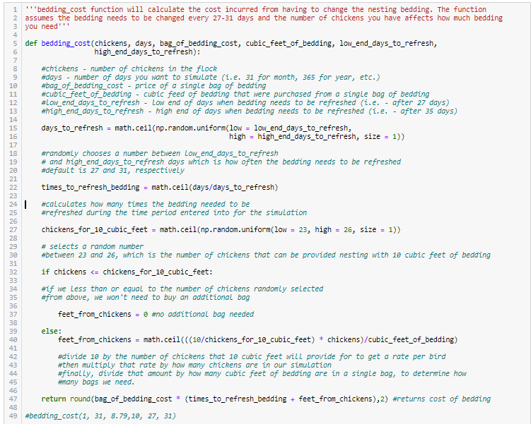
The Code
Three functions – One for each model, Revenue, Feed Cost, Bedding Cost

Slide 8
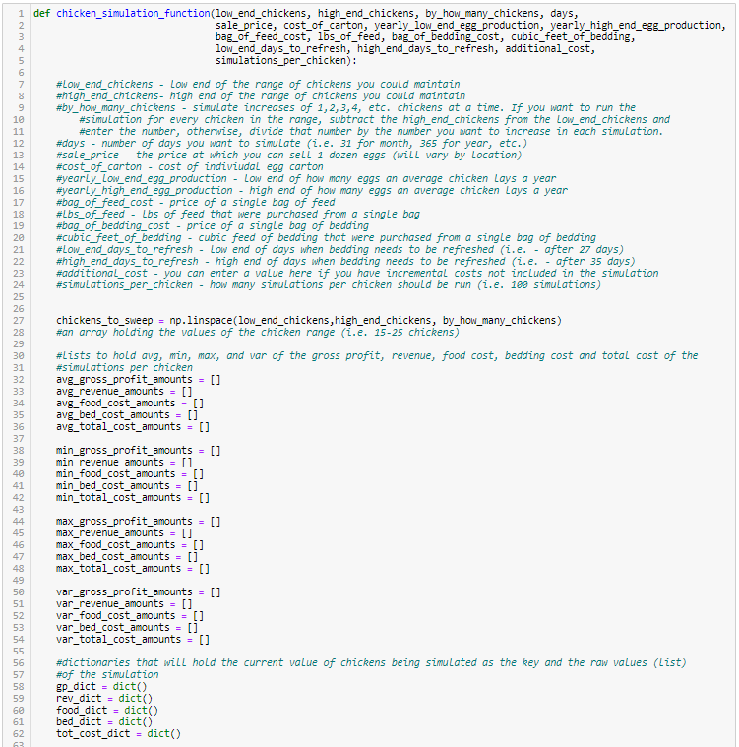
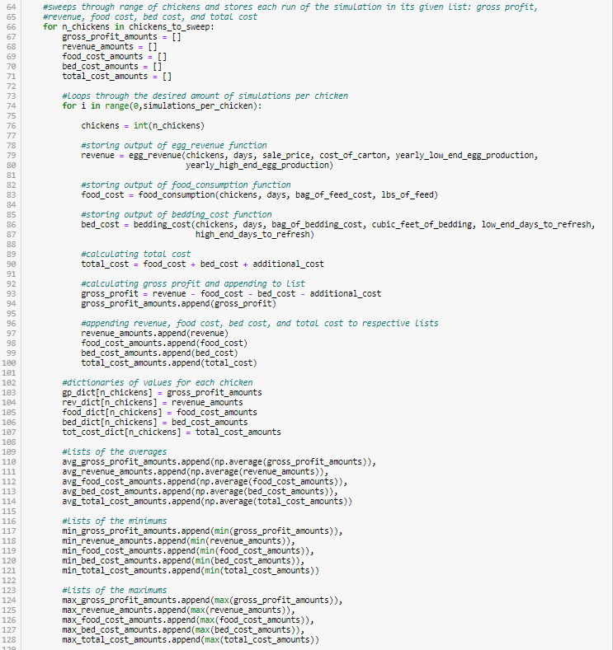
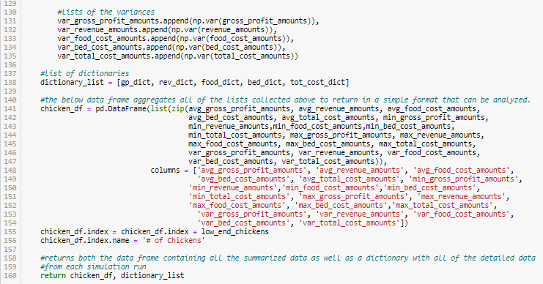
The Code – Part II
One simulation function to run all the other functions over the given range of chickens
Returns a Data Frame with min, avg, max, and variance of all runs as well as a dictionary with the detail of each individual run of the simulation (raw data).

Slide 9
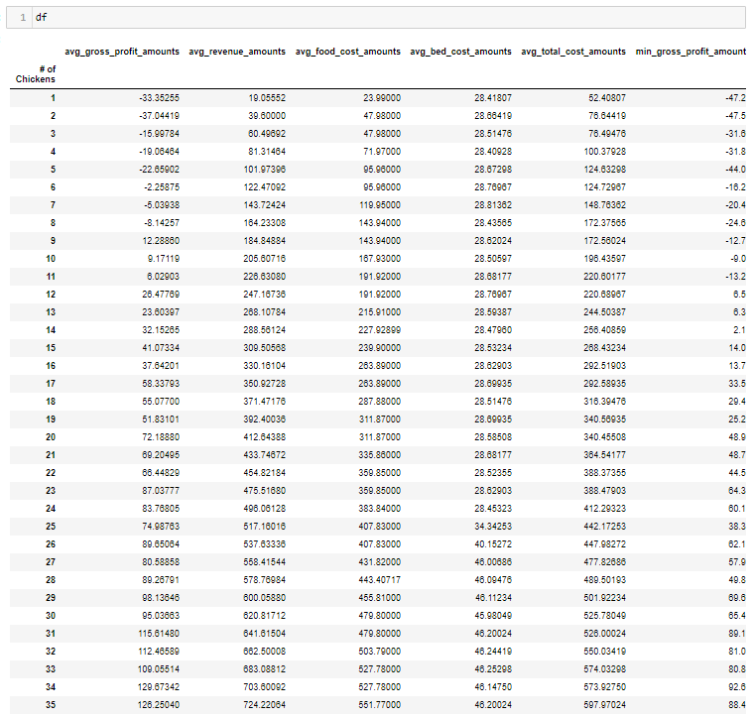
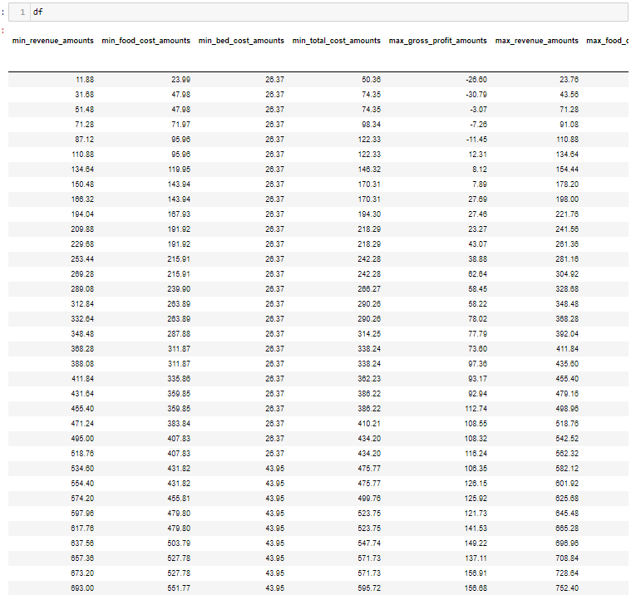
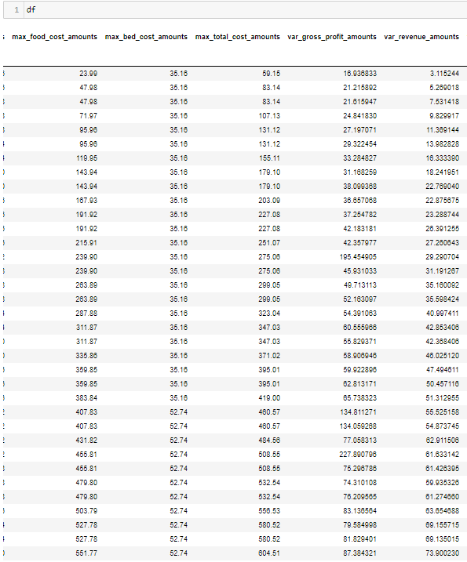
Output – Data Frame with all summarized Data

Slide 10
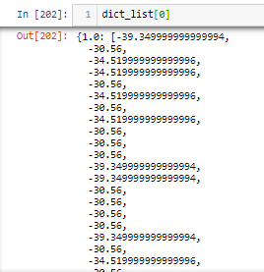
Output II – Dictionary with data from every run
Output for all 1000 runs of the simulation for the model with only 1 chicken.
Dictionary contains the output of the full range of chickens and holds the data for gross profit, revenue, feed cost, bedding cost, and total cost

Slide 11
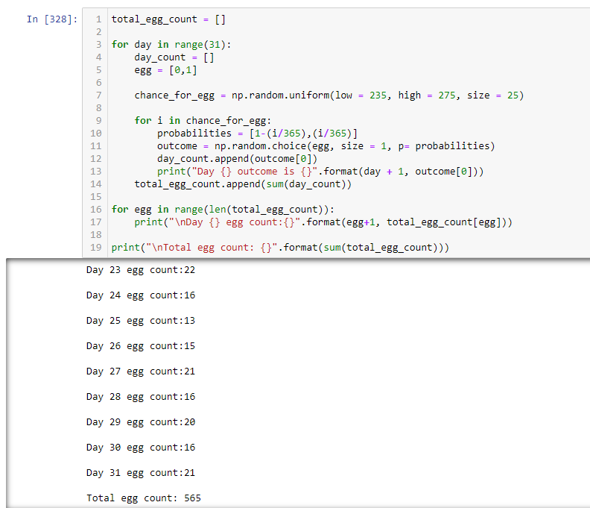
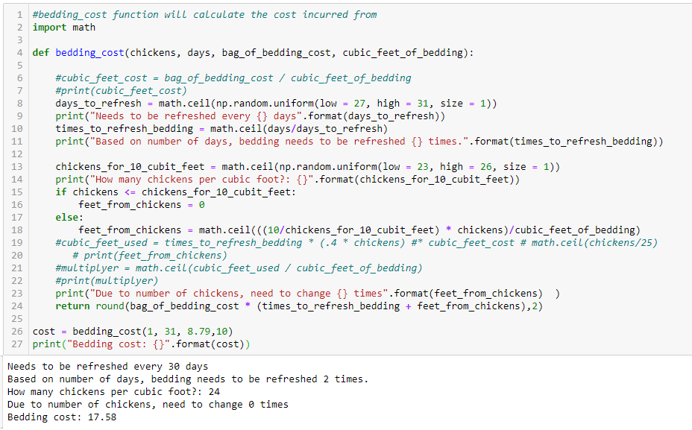
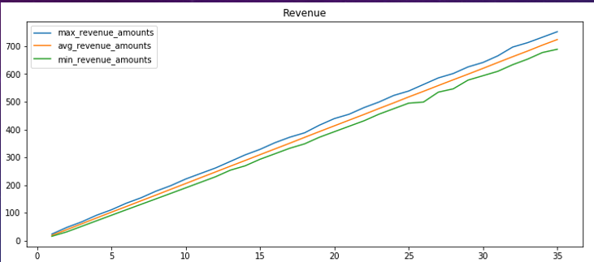
Validation
To validate my model I built it in small chunks and used a lot of print statements to validate that I was getting results that I expected using many different scenarios.
Also performed back of napkin calculations:
Total Eggs = 90 days /1.5 = how many eggs per chicken * 35 chickens
Total Eggs / 12 = 175 * 4.25 sale price = 743.75

Slide 12
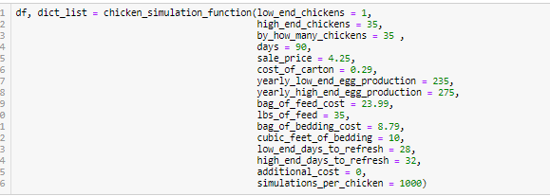
Running the Sim
To run the simulation simply enter values into the function parameters:
In this run we are saying we want to sweep between 1 and 35 chickens for 90 days.
We’ll sell each organic dozen of eggs for $4.25
Cost of a carton is $0.29
Egg production ranges between 235 and 275 eggs per year per chicken
Feed costs $23.99 for 35lbs
Bedding costs $8.79 for 10 cubic feet
We’ll need to change the bedding every 28-32 days
We want to run the simulation 1000 times for each chicken in the given range
Why 1,000? I tried several different values, 100, 500, etc.
1,000 seemed to capture the most variation which is what I wanted in my data set so I could be conservative when picking my optimal value

Slide 13
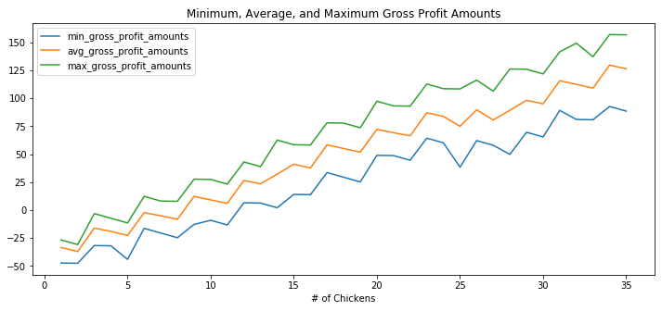
Analyzing the data
More isn’t always better…
Gross profit peaks at 34 chickens, not 35…
Let’s see why that is…

Slide 14
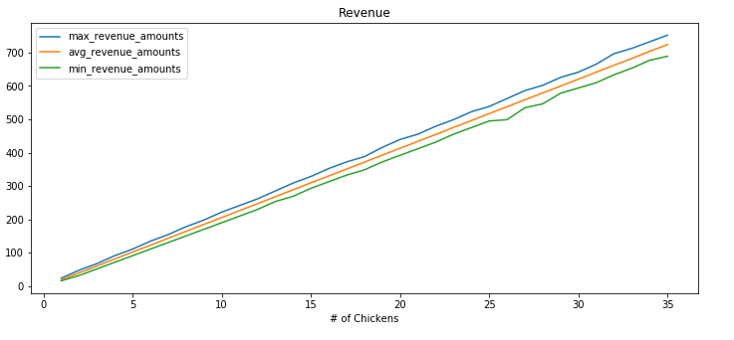
Revenue is linear

Slide 15
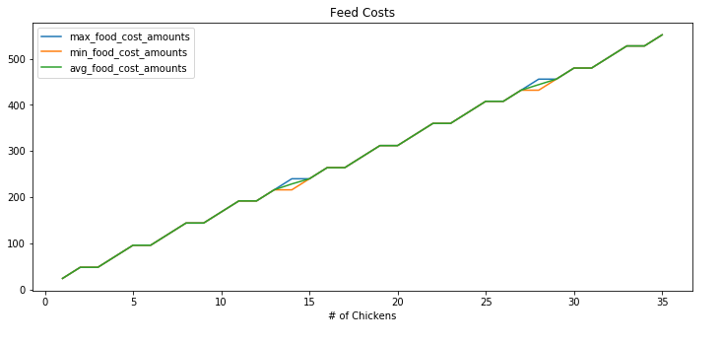
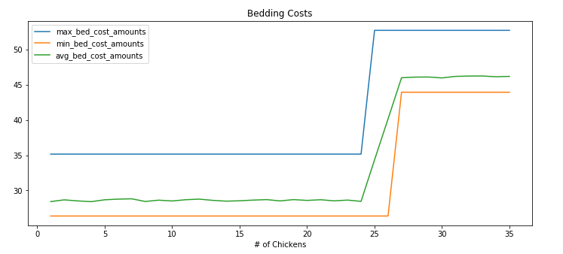
Costs are Not

Slide 16
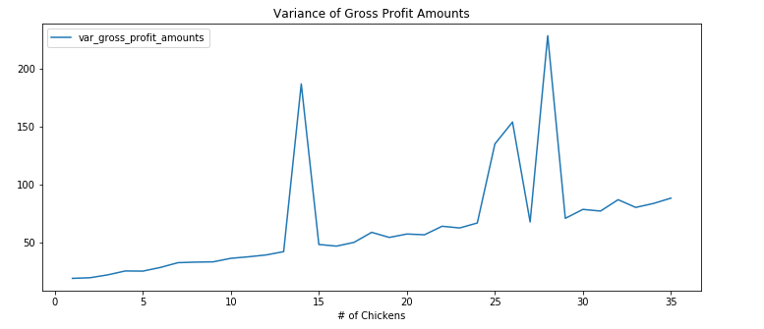
What about THE variance of Gross Profit?
Variance at
34 chickens is quite low. The square root is only ~$8.

Slide 17
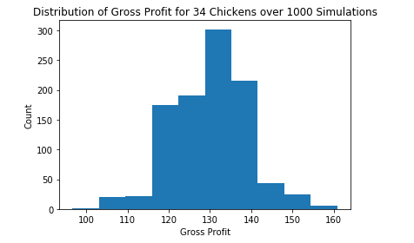
DIG IN to Gross Profit
While the minimum for this simulation is only $96, it is extremely unlikely. More likely for gross profit to be between $115-$140

Slide 18
THE Answer
We can say with extreme confidence that 34 chickens is the optimal number for our given scenario to maximize gross profit
Additionally, as we saw in the histogram of gross profit, there is significant potential to make more than the minimum value of $96 dollars.
34

Slide 19
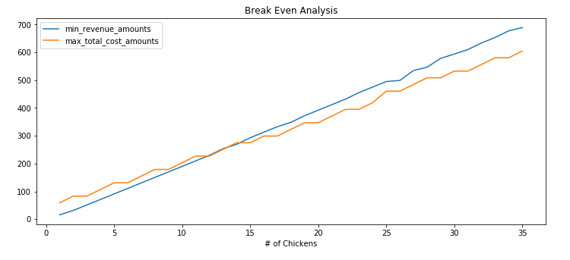

BREAKEVEN ANALYSIS
If our goal wasn’t to maximize profit but to breakeven with the least amount of chickens possible…
Two breakeven points, we’d need to dive into the details to see if 9 or 14 was the more conservative value

Slide 20
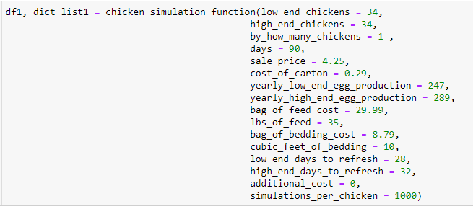
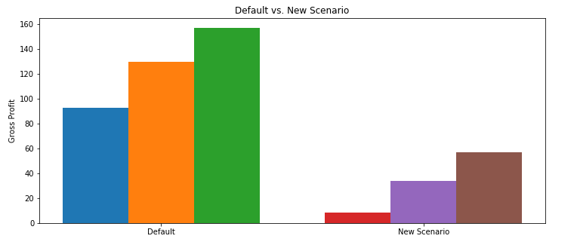
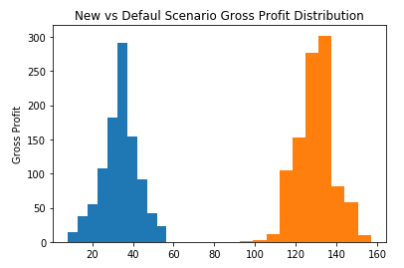
“WHAT IF” Analysis
New and Improved bag of feed
Claims 5% increase in egg production
Costs $6 more than our current bag
IS IT WORTH IT? – increase in GP?
Adjust parameters:
DON’T DO IT!

Slide 21
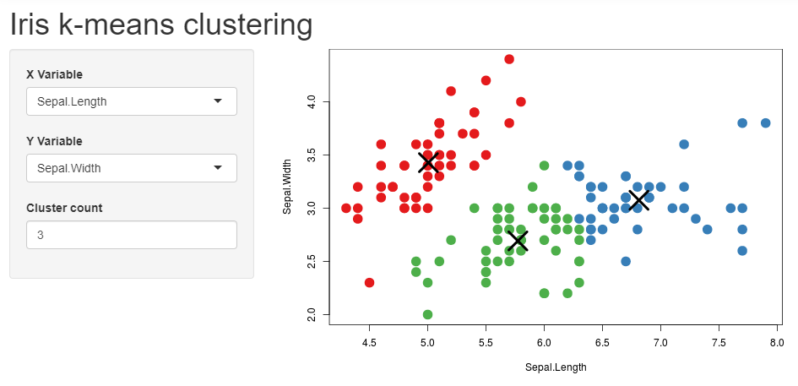
Next Steps
R Shiny App – Build a front end UI
“What If" scenario to decide whether or not to buy a more expensive bag of bedding that boasts less frequent bedding changes

